Slide 1
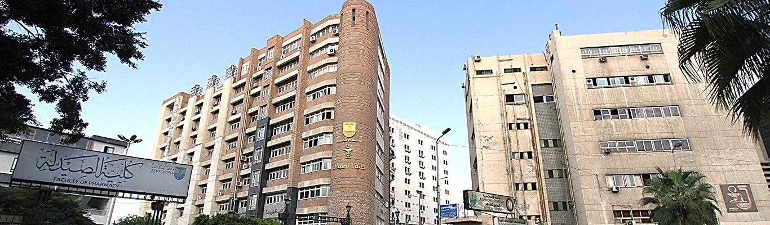

Annual Report
For Graduate Studies and Research Activities

Slide 2
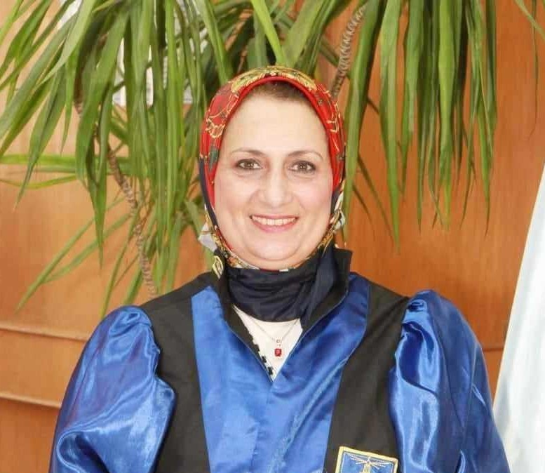
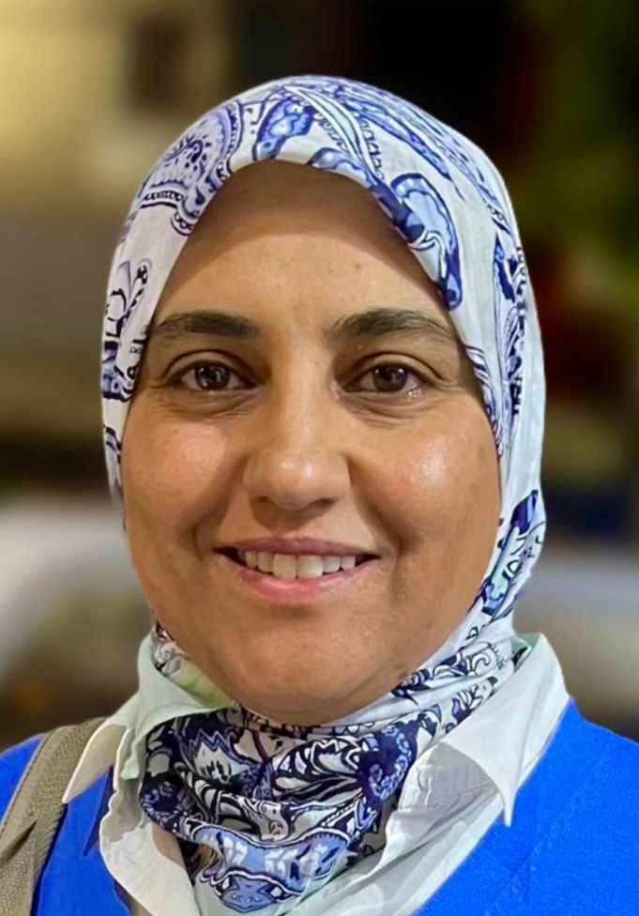


Function Structure
Vice dean for graduate studies and research
Assistant vice dean for graduate studies and research
Post grade Office
Secretariat vice dean for graduate studies and research

Slide 3
Sub - Committees of the Graduate Studies Committee
Libraries Committee
Support fund Scientific Research Committee
Ethics Committee
Scientific Awards Committee
Interdisciplinary programs Committee
Post grade Committee
Mandatory leave Committee
Faculty employees Awards Committee
IACUC Committee
Continuing Education Committee
Complaints and Suggestions Committee
Professional development committee
College magazine Board of Directors

Slide 4









The Scientific Theses Support Fund Committee
Year | Cost | Degree | Department | name
2024-2025 | 15000 | PhD | Microbiology & immunology | Hadeer Aly
2024-2025 | 15000 | PhD | Microbiology & immunology | Abd El Rahman Saad
2024-2025 | 15000 | PhD | Pharmacognosy | Sara Magdy
2024-2025 | 15000 | PhD | Pharmaceutics | Eman Gaber
2024-2025 | 15000 | PhD | Pharmaceutics | Aya Khallaf
2024-2025 | 10000 | MSc | Microbiology & immunology | Ahmed Fouad
2024-2025 | 10000 | MSc | Pharmacognosy | Nesma Alash
2024-2025 | 10000 | MSc | Pharmacognosy | Aisha Hazem
2024-2025 | 10000 | MSc | Pharmacology & Toxicology | Marian George
2024-2025 | 10000 | MSc | Pharmacology & Toxicology | Rahma El Ghabary
2024-2025 | 10000 | MSc | Clinical Pharmacy & Pharmacy Practice | Sara Adel
2024-2025 | 10000 | MSc | Clinical Pharmacy & Pharmacy Practice | Hanan Ragab
2024-2025 | 10000 | MSc | Industrial pharmacy | Hoda Khaled
2024-2025 | 10000 | MSc | Analytical chemistry | Nermeen Mohamed
2024-2025 | 10000 | MSc | Pharmaceutics | Eman Adel
2024-2025 | 10000 | MSc | Pharmaceutical chemistry | Mariam Salah
2024-2025 | 10000 | MSc | Pharmaceutical chemistry | Youssef Saleh
The committee submits a number of (12) Msc and PhD theses and the committee agreed to Fund them with 10000 pounds for each thesis to be disbursed from the clinical pharmacy item, with a total amount of 120000 pounds
Similarly, the committee agreed to support) 5) Phd theses for various purposes, with 15000 pounds for each thesis to be disbursed from the clinical pharmacy item, with a total amount of 75000 pounds

Slide 5
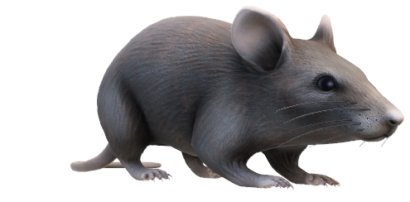
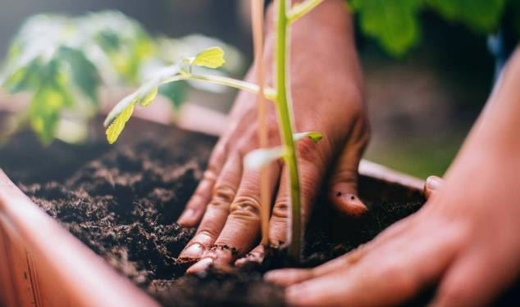


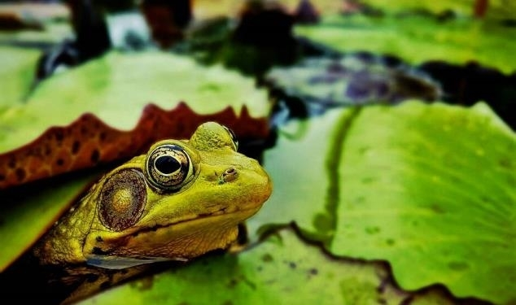
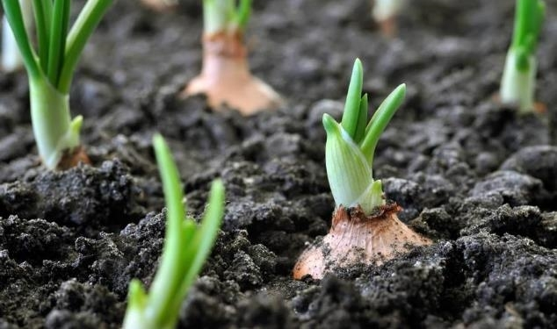
Ethics Committee Report
Project (11)
Research (13)
Msc (27)
Phd (8)
Research (11)
Project (2)
Msc (16)
Phd (10)
Research (6)
Ethical Approval on Animal Form
Incomplete non- Medical Approval Form
Ethical Approval Exemption Form
Attachment (5) is a declaration by the applicant that he has previous ethical approval for the scientific theses (Master’s - PhD), which number (18)

Slide 6


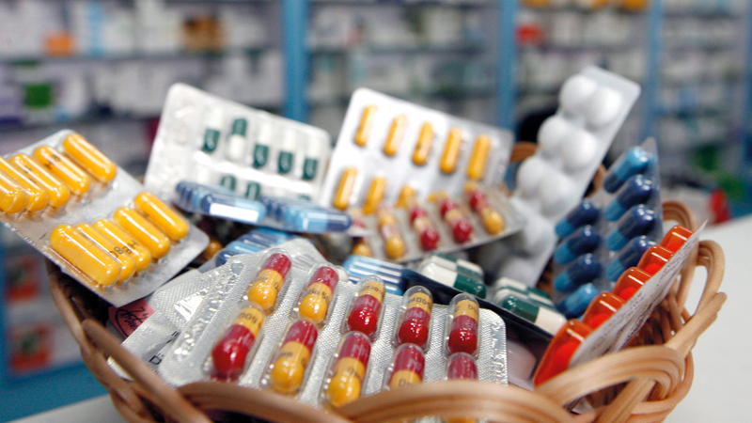
New degrees in the field of postgraduate studies
Master’s degree in Pharmacogenomics between the department of Biochemistry and Pharmacology & Toxicology By Ministerial decision No. 2533 Date: 27/9/2023
Diploma in Pharmacogenomics between the department of Biochemistry and Pharmacology & Toxicology By Ministerial decision No. 2533 Date: 27/9/2023
Professional Diploma in Pharmacovigilance & Regulatory Affairs (intermediate degree) between the department of Clinical Pharmacy and Pharmacy Practice and Pharmaceutics
By Ministerial decision No. 396 Date: 20/2/2024

Slide 7



New Degrees under construction
Professional Diploma in Sports Pharmacy Practice at the department of Clinical Pharmacy and Pharmacy Practice.
Professional Master in Radio Pharmacy as a dual degree between the department of Pharmaceutical Analytical Chemistry and Medical Research Institute at Alexandria University in collaboration with the Egyptian Atomic Energy Authority.
Master in Drug Design at the department of Pharmaceutical Chemistry, it is a dual degree between Faculty of Pharmacy – Alexandria University and Caen Normandie – France.
Professional master in Pharmacoeconomics at the department of clinical pharmacy and pharmacy practice.

Slide 8

Master’s Degree in Pharmaceutical Sciences in the following specializaions:
9 Departments
Pharmacogenomics
Doctor of Philosophy Degree in Pharmaceutical Sciences in the following specializaions:
9 Departments
Diploma:
Diploma in Cosmetic Preparations and Entrepreneurship
Diploma in Hospital and Clinical Pharmacy
Diploma in Biochemical Analysis
Diploma in Medicinal Plants and Traditional Therapeutics

Slide 9
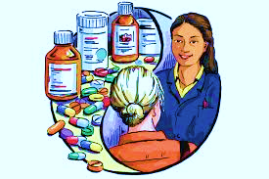
Some Modifications to previously existing degrees
Changing the name of department Pharmaceutical biochemistry to the department of BIochemistry
By Ministrial Decision No. 3212 Date: 29/8/2022
Changing the name of department Pharmacy Practice to the department of Clinical Pharmacy and Pharmacy Practice
By Ministrial Decision No. 3212 Date: 29/8/2022
Changing the classification of the degree of Pharm D from Professional degree to Professional master’s degree
In the Pharmaceutical studies sector committee at its session held on 30/12/2024

Slide 10
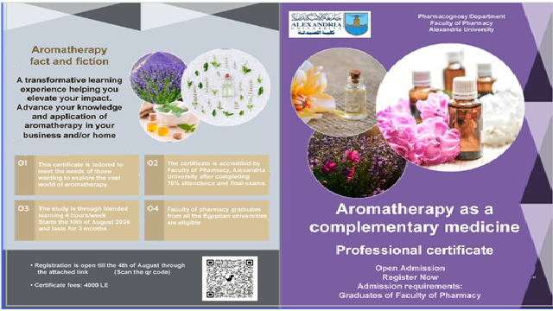
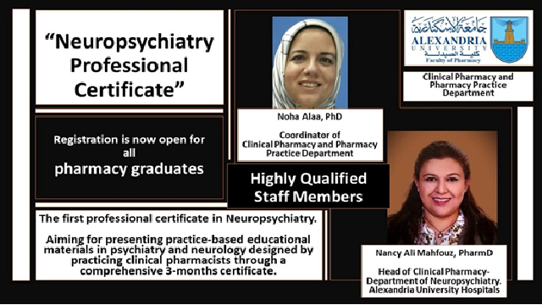
Professional Certificates
A professional certificate entitled “ِApplication of Genomics and Pharmacogenomics in cancer” granted by the Departments of Biochemistry and Pharmacology and Toxicology. It was offered on 13/8/2023 and extended until 30/8/2023 , and 23 graduate students enrolled in it .
A professional certificate entitled ”Neuropsychiatric clinical pharmacy practice” granted by the Departments of Clinical Pharmay & Pharmacy Practice. It was offered on 20/4/2024 with 36 graduate students enrolled in it , another from 5/2024 to 8/2024 (36 students) and another from 10/2025 to 1/2026 (40 students).

Slide 11

A professional certificate entitled ”Aromatherapy as Complementary Medicine” granted by the Departments of Pharmacognosy . It was offered from 18/8/2024 to 11/2024 and 16 graduate students enrolled in it.
A professional certificate entitled ”Clinical Nutrition” granted by the Departments of Biochemistry . It was offered on 26/8/2024 and 18 graduate students enrolled in it.

Slide 12
A professional certificate entitled ‘’Pharmaceutical manufacturing excellency: GMP“ granted by Analytical chemistry department. It was offered from 7/2025 to 9/2025 with 14 postgraduate students enrolled in it.
A professional certificate entitled ‘’Sports pharmacy‘’ granted by Clinical pharmacy and pharmacy practice department. It was offered from 5/2025 to 8/2025 with 14 postgraduate students enrolled in it.
A professional certificate entitled ‘’فكرتك شركتك‘’ granted by the postgraduate sector. It was offered from 7/2025 to 9/2025 with 11 postgraduate students enrolled in it.

Slide 13
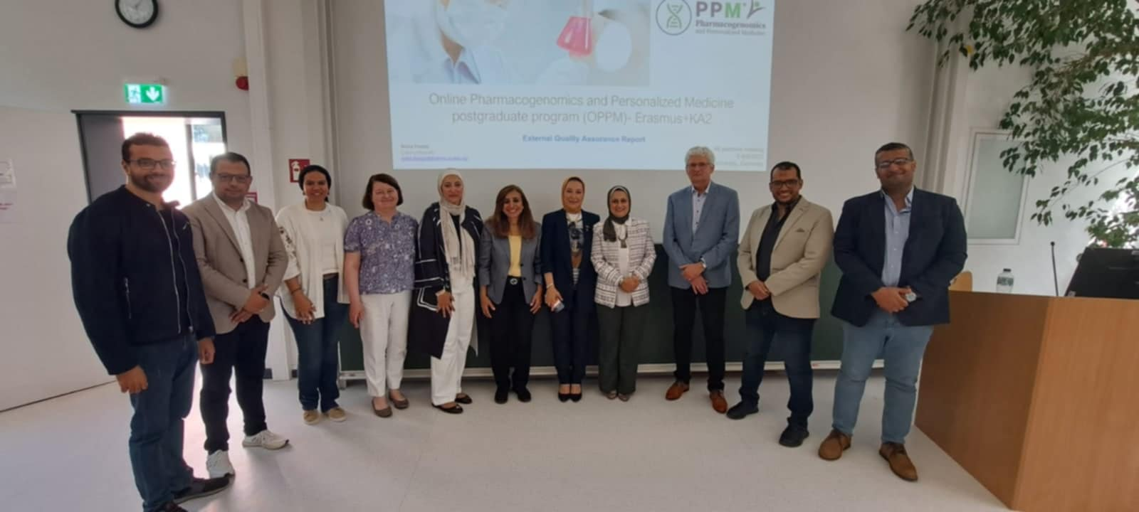
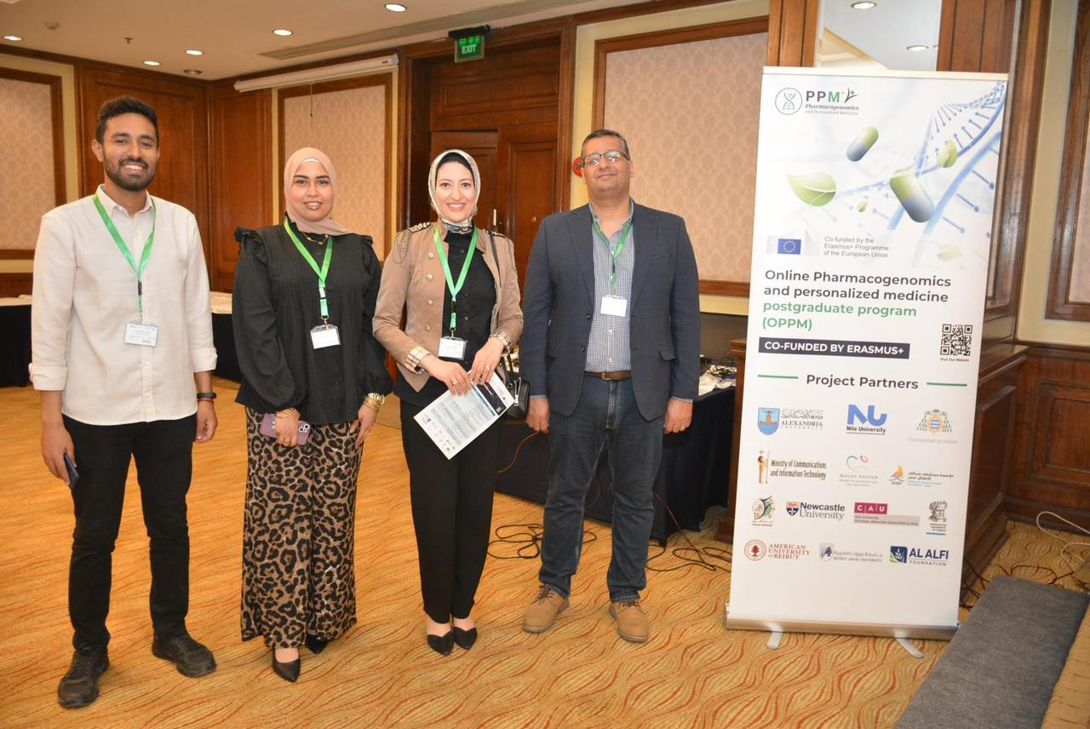
International & Local Confenernce

Slide 14

External Mission
name | Functional | Deptment | State | From | To
Lina elsayed | Assistant Lectuer | Microbiology & immunology | England | 30/9/2020 | 29/3/2025
Shams Fathy | Assistant Lectuer | pharmaceutics | England | 15/12/202 | 14/12/2024
Abd El Rahman Yassin | Assistant Lectuer | Industrial Pharmacy | England | 11/4/2022 | 10/4/2026
Heba Abd el megid | Assistant Lectuer | pharmaceutics | Holand | 24/8/2022 | 23/8/2026

Slide 15
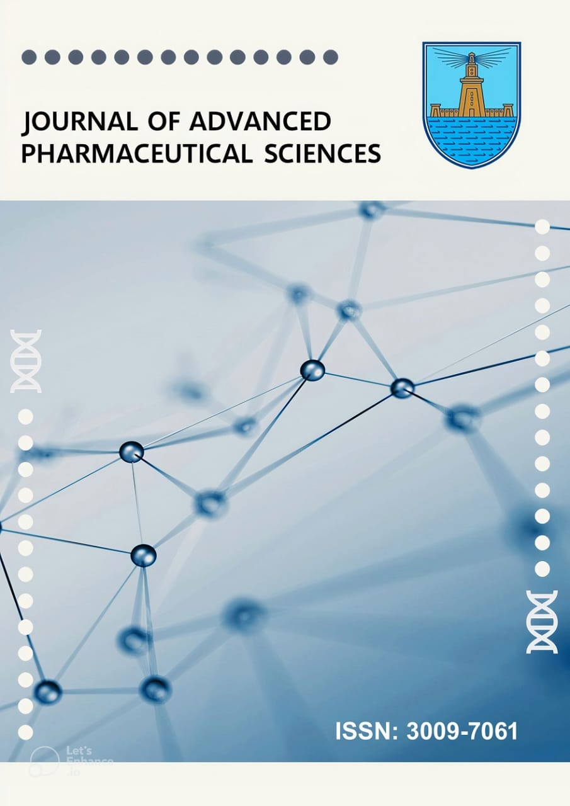
JOURNAL OF ADVANCED PHARMACEUTICAL SCIENCES
The Journal was evaluated by the Supreme Council of Universities and received a score of 6.5/7

Slide 16
An EDITORIAL BOARD for the Faculty magazine was formed in the gradue studies committee at the session held on 11/3/2023 and the Faculty council held on 17/3/2023 and extending until 24/3/2023 by the following gentleman whose names are:
الاسم | الاسم | الاسم
Prof. Dr. Amal Hassan El-kamel- Emeritus Professor in Pharmaceutics | Dr. Noha Alaa Eldin Hassan | Dr. Heba Abd El Azim
Prof. Dr. Eman Shawky Anwer – Professor and chairman of the department council of Pharmacognosy | Dr. Radwa Emad | Dr. Marwa Shoir
Prof. Dr. Mohammed Maher Mohammed | Dr. Sarah El Lakany | Dr. Ahmed Abel Elmoniem
Prof. Dr. Amira Fawzy El-yazbi | Dr. Salma El Habashy | Dr. Assr Fazwy
Dr. Ahmed Said Belal | Dr Salwa Abo Ragih | Dr. Ali Amin
Dr. Reham Said Ibrahim | Dr. Hala Shafiq | Dr. Shams Tarek
Dr. Parihan El zahar | Dr. Maikel Gorge | Dr. Sarah El Garwani
Dr. Reham Mohammed El-moslmany | Dr. Reem Hassan El hamamy | Dr. Asmaa Hossam
Dr. Asmaa Ashour | Dr. Hadel Adel | Dr. Ahmed Foad
Dr. Abd El Rahman zakria | Dr. Walaa Metwaly | Dr. Aya Refaat

Slide 17
The ISSN was obtained for the Faculty's journal JOURNAL OF ADVANCED PHARMACEUTICAL SCIENCES “ in November 2023
ISSUE 1 in January 2024
ISSUE 2 in June 2024
Issue 3
Jan 2025
Issue 4
June 2025
1 | Hospital and Clinical Pharmacy
1 | Pharmaceutical Analytical Chemistry
1 | Pharmaceutical microbiology
5 | Pharmacognosy and Phytochemistry
3 | Pharmacognosy and Phytochemistry
1 | Pharmaceutical Microbiology

Slide 18
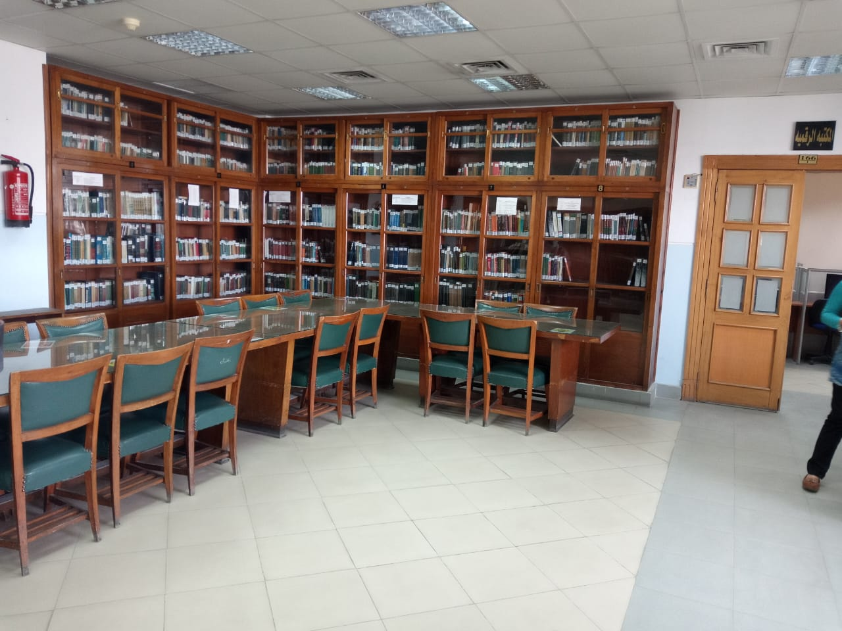
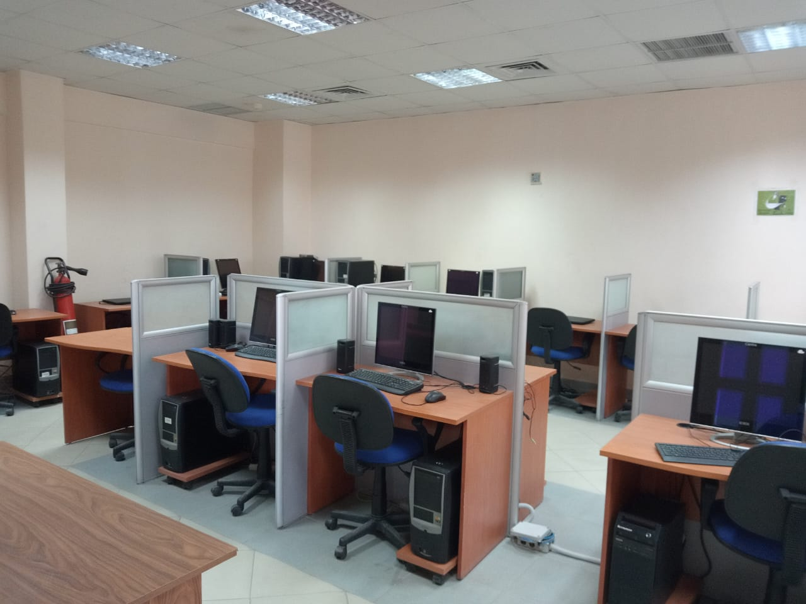
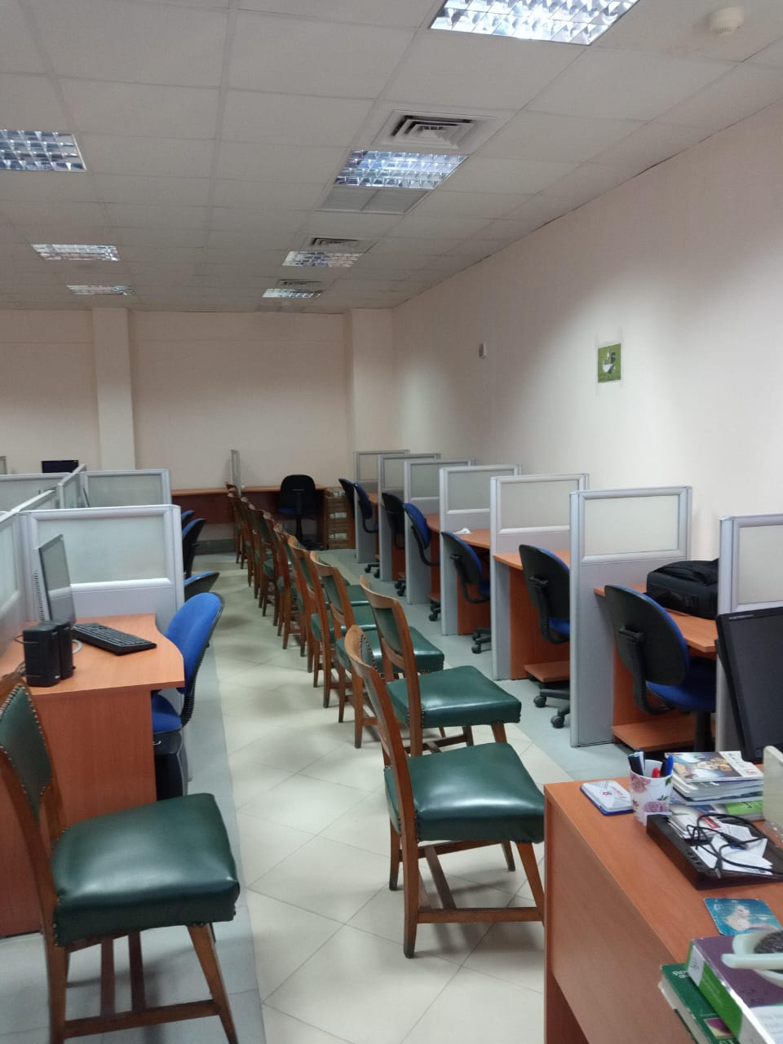
Faculty library
9 books, other than British Pharmacopeia, were purchased for approximately 66.719 thousand pounds
The book has been added to the Faculty library
Pharmacotherapy Principles and Practice Fifth Edition .2019
Natural poison and venom Phytochemical in medicinal Plants Nutrimetabolomics
INSTRUMENTAL ANALYTICAL CHEMISTRY ROBINSON 2022
GREEN APPROACHES FOR CHEMICAL ANALYSIS * Emanuela Gionfriddo2024
Chemical Biology & drug Design
Razdan Drug Design 2023
Nanotechnology in drug delivery and pharmaceuticals by toby cabral.2023
ESSENTIALS OF HOSPITAL INFECTION CONTROL
production technology for medicinal and aromatic cropsChhaya singh
British pharmacopeia 2024

Slide 19
بند 9 ابحاث

Slide 20


