Slide 1
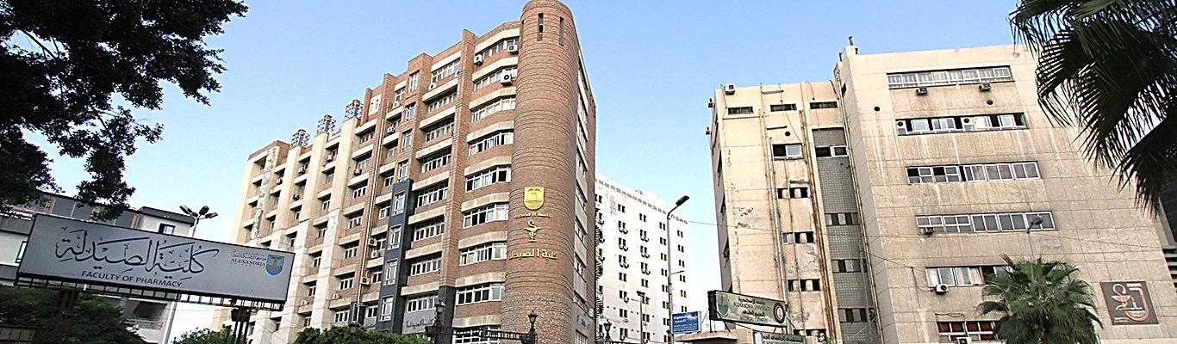

Annual Report
For Graduate Studies and Research Activities
Academic Year 2023-2024

Slide 2
Agenda
Functional structure
Sub - Committees of the Graduate Studies Committee
Award-winning faculty Members,
Support fund Scientific Research
Ethics Committee
A new course in the field of postgraduate studies
Course in construction Agreed
Professional Certificates
Distinguished Scientific Publishing
Scientific Missions, international and local conferences, including foreign ones
Faculty Journal
Faculty library
Academic exchange
New students for graduate programs
Students awarded a postgraduate programs

Slide 3
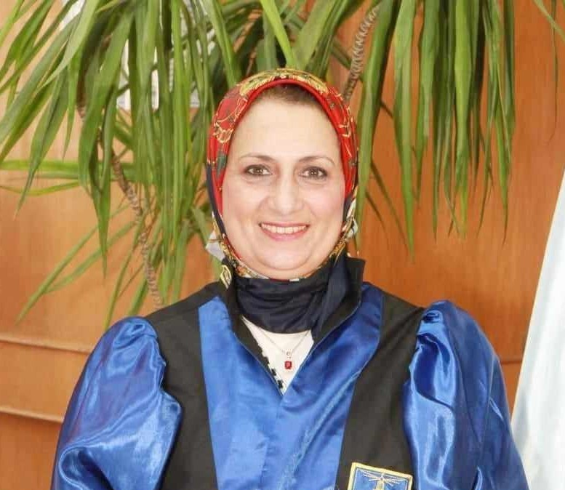
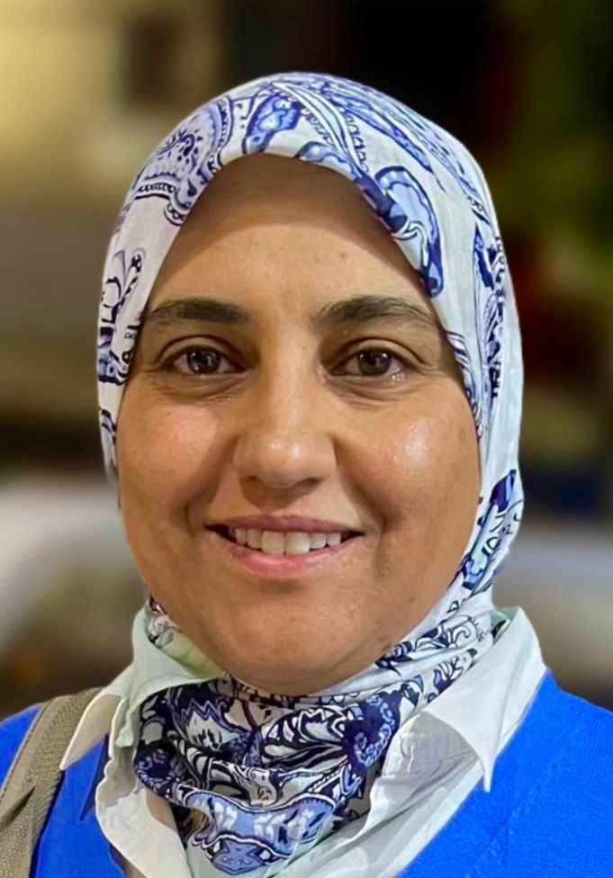


Function Structure
Vice dean for graduate studies and research
Assistant vice dean for graduate studies and research
Post grade Office
Secretariat vice dean for graduate studies and research

Slide 4
Sub - Committees of the Graduate Studies Committee
Libraries Committee
Support fund Scientific Research Committee
Ethics Committee
Staff Awards Committee
Interdisciplinary programs Committee
Post grade Committee
Mandatory leave Committee
Faculty Awards Committee
IACUC Committee
Complaints and Suggestions Committee
Continuing Education Committee
College magazine Board of Directors

Slide 5

Award-winning faculty Members
Examination of teaching staff files applying for any awards , in 2023-2024 were nominated for :
First: The University Appreciation Award:
“Mrs. Prof. Dr. Amal Hassan El-kamel - Emeritus Professor at the Department of Pharmaceutics
Second: The University Award for Distinguished Scientific Publication Shield:
“Mr. Dr. Mohammed Teleb El-bassiony- Assistaint Professor at the Department of Pharmaceutical Chemisty
Third: The University Award for Scientific Encouragement:
“Mrs.. Dr. Asmaa Ahmed Ashour- Lecturer at the Department of Pharmaceutics
Awards
In 2023 -2024 were received for University Appreciation Award “Mrs. Prof. Dr. Hala Mostafa Hammoda – Professor at the Department of Pharmacognosy and Vice dean for Graduate Studies and Research”

Slide 6









The Scientific Theses Support Fund Committee
The committee submits a number of (12) Msc and PhD theses and the committee agreed to support) 7) master’s theses for various purposes, with 15000 pounds for each thesis to be disbursed from the clinical pharmacy item, with a total amount of 105000 pounds
the committee agreed to support) 5) Doctor's theses for various purposes, with 25000 pounds for each thesisto be disbursed from the clinical pharmacy item, with a total amount of 125000 pounds
Obtaining a number of (4) dissertations, including (2) Ph.D., (2) Master’s in Excellence Research, 5000 European pounds (fifth and sixth), with a value of only 3000 pounds (seventh) for each research disbursed under clinical pharmacy, with a total amount of 18000 pounds.
Year | Cost | Degree | Department | name
2023-2024 | 25000 | PhD | Microbiology & immunology | Mona sheriff
2023-2024 | 25000 | PhD | Microbiology & immunology | Marwa Reda
2023-2024 | 25000 | PhD | Pharmacognosy | Safa yasin
2023-2024 | 25000 | PhD | Pharmacology & Toxicology | Hager hamdy
2023-2024 | 25000 | PhD | Pharmaceutics | Marwa Shair
2023-2024 | 15000 | MSc | Pharmaceutical Analytical Chemistry | Salma mahmoud
2023-2024 | 15000 | MSc | Pharmaceutics | Asmaa Kamel
2023-2024 | 15000 | MSc | Pharmaceutics | Sara El - khedr
2023-2024 | 15000 | MSc | biochemistry | Sarah Mohamed
2023-2024 | 15000 | MSc | Pharmaceutical Chemistry | Ali Amin
2023-2024 | 15000 | MSc | Clinical Pharmacy & Pharmacy Practice | Katrin Samir
2023-2024 | 15000 | MSc | Pharmacology & Toxicology | Aya Mostafa
2023-2024 | 5000 | PhD | Pharmacognosy | Asmaa khairy
2023-2024 | 5000 | MSc | Pharmaceutics | Eman gaber
2023-2024 | 5000 | PhD | Pharmacognosy | Mariam Mohamed
2023-2024 | 3000 | MSc | Pharmaceutics | Alaa reda

Slide 7
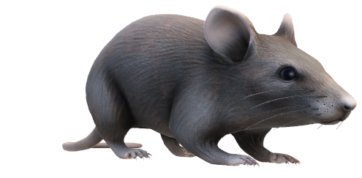




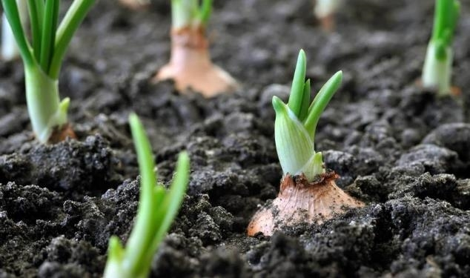
Ethics Committee Report
Msc (3)
Phd (2)
Research (8)
Ethical Approval Waiver Form
Msc (23)
Phd (11)
Research (20)
Msc (27)
Phd (9)
Research (24)
Ethical Approval on Animal Form
Incomplete non- Medical Approval Form
Attachment (5) is a declaration by the applicant that he has previous ethical approval for the scientific theses (Master’s - PhD), which number (18)

Slide 8


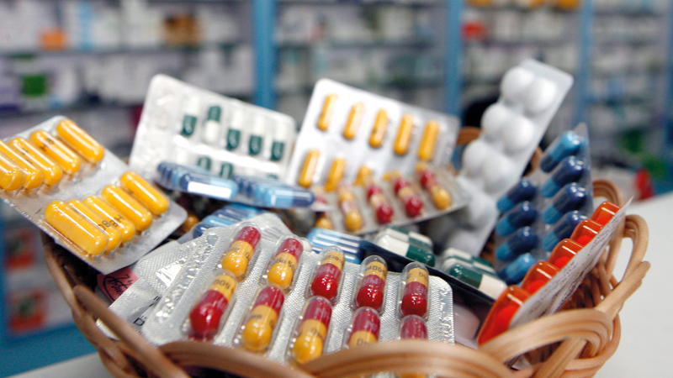
New degrees in the field of postgraduate studies
Master’s degree in Pharmacogenomics (intermediate degree) between the department of Biochemistry and Pharmacology & Toxicology
By Ministerial decision No. 2533 Date: 27/9/2023
Diploma in Pharmacogenomics (intermediate degree) between the department of Biochemistry and Pharmacology & Toxicology
By Ministerial decision No. 2533 Date: 27/9/2023
Professional Diploma in Pharmacovigilance & Regulatory Affairs (intermediate degree) between the department of Clinical Pharmacy and Pharmacy Practice and Pharmaceutics
By Ministerial decision No. 396 Date: 20/2/2024
Professional Master in Pharmacovigilance & Regulatory Affairs at the department of Clinical Pharmacy and Pharmacy Practice
Waiting for the ministerial decision after obtaining the approval
of the University’s Graduate Studies and Research Committee,
held on 22/5/2024 and extending until 30/5/2024

Slide 9
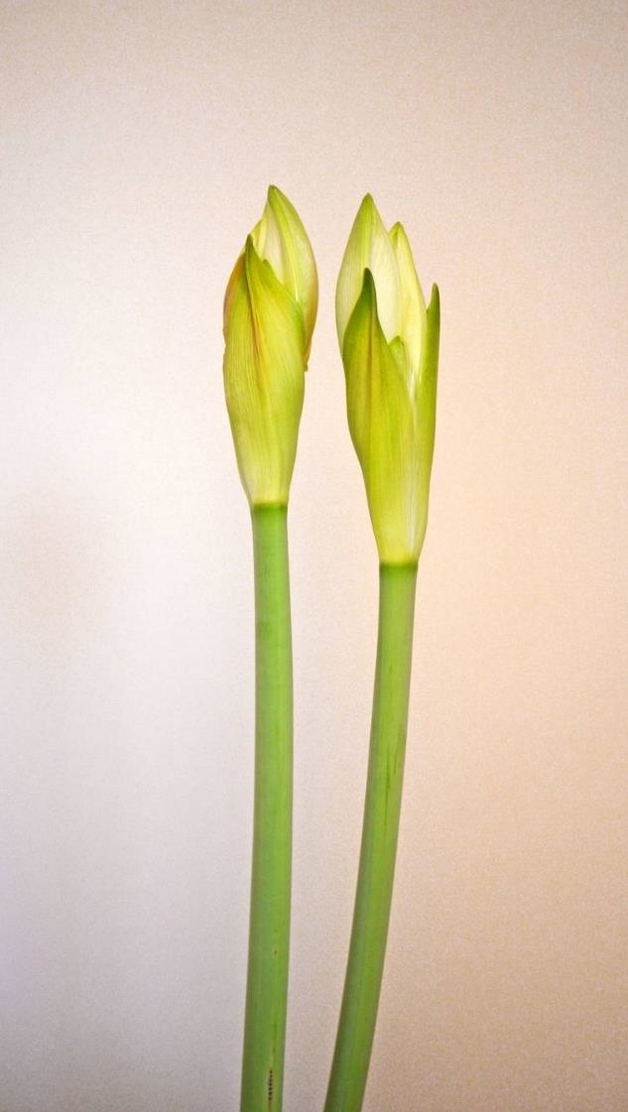



New Degrees under construction
Professional Diploma in Soprts Pharmacy Practice at the department of Clinical Pharmacy and Pharmacy Practice
Professional Master in Radio Pharmacy at the department of Pharmaceutical Analytical Chemistry
Master in Drug Design at the department of Pharmaceutical Chemistry, it is a double degree between Faculty of Pharmacy – Alexandria University and Caen Normandie - France

Slide 10
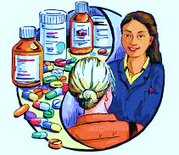
Some Modifications to previously existing degrees
Changing the name of department Pharmacy Practice to the department of Clinical Pharmacy and Pharmacy Practice
By Ministrial Decision No. 3212 Date: 29/8/2022
Changing the classification of the degree of Pharm D from Professional degree to Professional master’s degree
In the Pharmaceutical studies sector committee at its session held on 30/12/2024

Slide 11

Post grade Programs in Academic Year 2023-2024
Master’s Degree in Pharmaceutical Sciences in the following specializaions:
Pharmaceutics
Pharmacology & Toxicology Microbiology & Immunology
Pharmaceutical Chemistry Pharmacognosy
Biochemistry
Clinical Pharmacy & Pharmacy Practice
Doctor of Philosophy Degree in Pharmaceutical Sciences in the following specializaions:
Pharmaceutics
Pharmaceutical Analytical Chemistry
Clinical Pharmacy & Pharmacy Practice
Pharmaceutical Chemistry
Biochemistry
Pharmacognosy
Diploma:
Diploma in Cosmetic Preparations and Entrepreneurship
Diploma in Hospital and Clinical Pharmacy
Diploma in Biochemical Analysis
Diploma in Medicinal Plants and Traditional Therapeutics

Slide 12
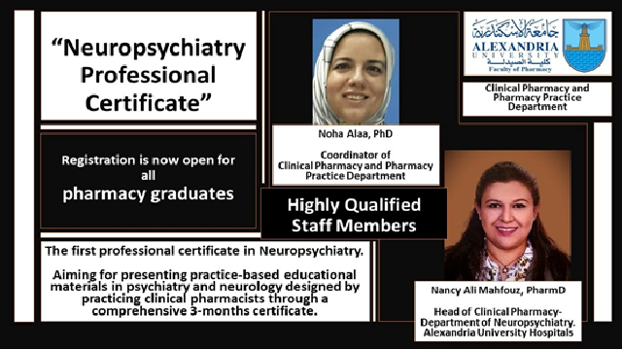
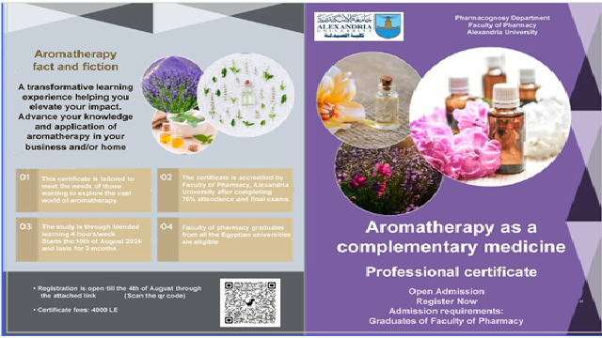

Professional Certificates
A professional certificate entitled “Pharmacogenomics of rare and inherited diseases" granted by the Departments of Biochemistry and Pharmacology and Toxicology. It was offered on 14/8/2023 and extended until 28/8/2023 , and 9 graduate students enrolled in it .
A professional certificate entitled “ِApplication of Genomics and Pharmacogenomics in cancer” granted by the Departments of Biochemistry and Pharmacology and Toxicology. It was offered on 13/8/2023 and extended until 30/8/2023 , and 23 graduate students enrolled in it .
A professional certificate entitled ” Neuropsychiatric clinical pharmacy practice” granted by the Departments of Clinical Pharmay & Pharmacy Practice. It was offered on 20/4/2024, and 35 graduate students enrolled in it .
A professional certificate entitled ” Aromatherapy as Complementary Medicine” granted by the Departments of Pharmacognosy . It was offered on 18/8/2024, and 16 graduate students enrolled in it
A professional certificate entitled ” Clinical Nutrition” granted by the Departments of Biochemistry . It was offered on 26/8/2024, and 18 graduate students enrolled in it

Slide 13
Distinguished Scientific Publishing
Research reward

Slide 14
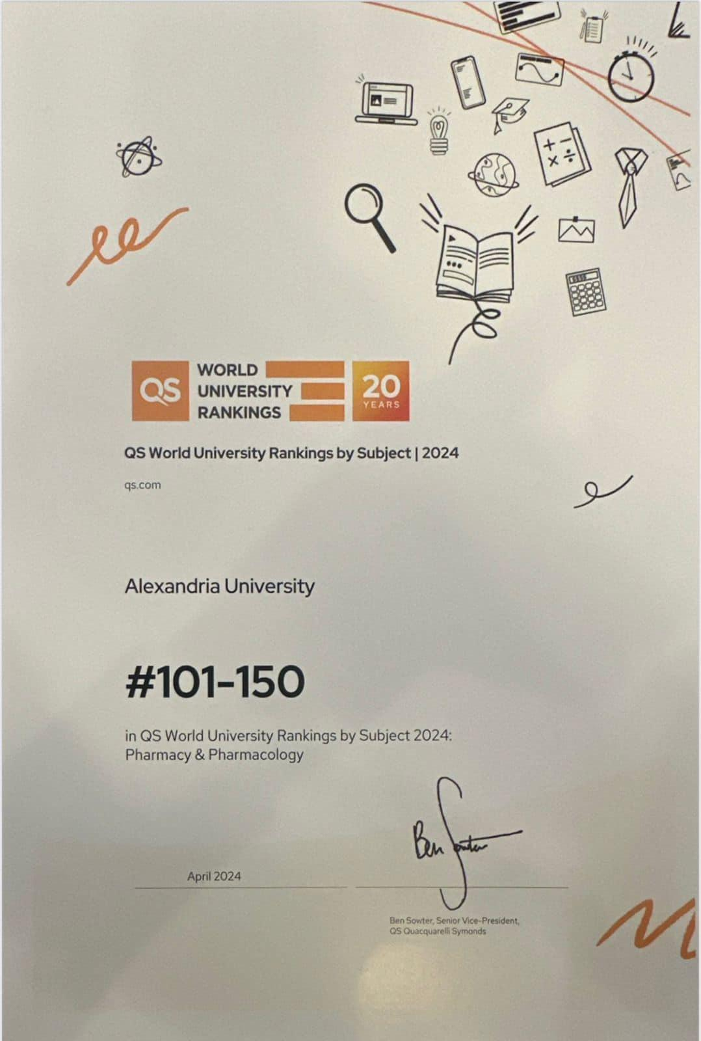
Distinguished Scientific Publishing
Global Ranking
Research published in Scopus | Research published in Q3 | Research published in Q2 | Research published in Q1
3 | 1 | 50 | 81

Slide 15
Distinguished Scientific Publishing
Citation Reward

Slide 16
Scientific Departments
Microbiology & Immunology (1)
Industrial Pharmacy (1)
Pharmacology & Toxicology (2)
Pharmaceutics (1)
Pharmacognosy (2)
State
)USA –Canada Japan–- London – France)
Scientific Mission

Slide 17
Statement of academic leave

Slide 18
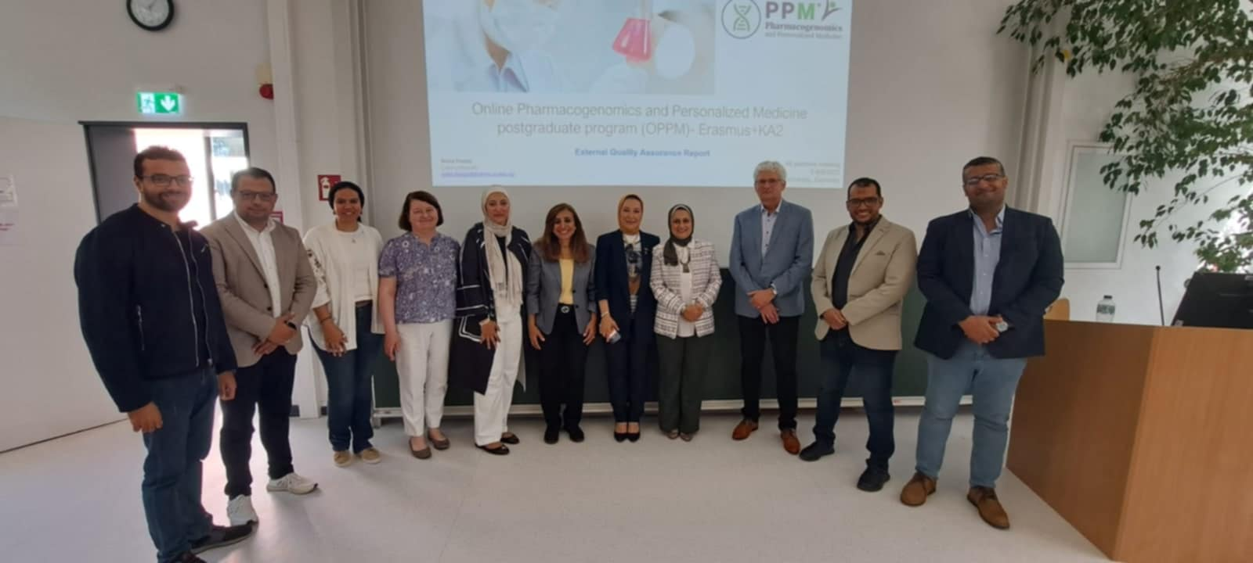
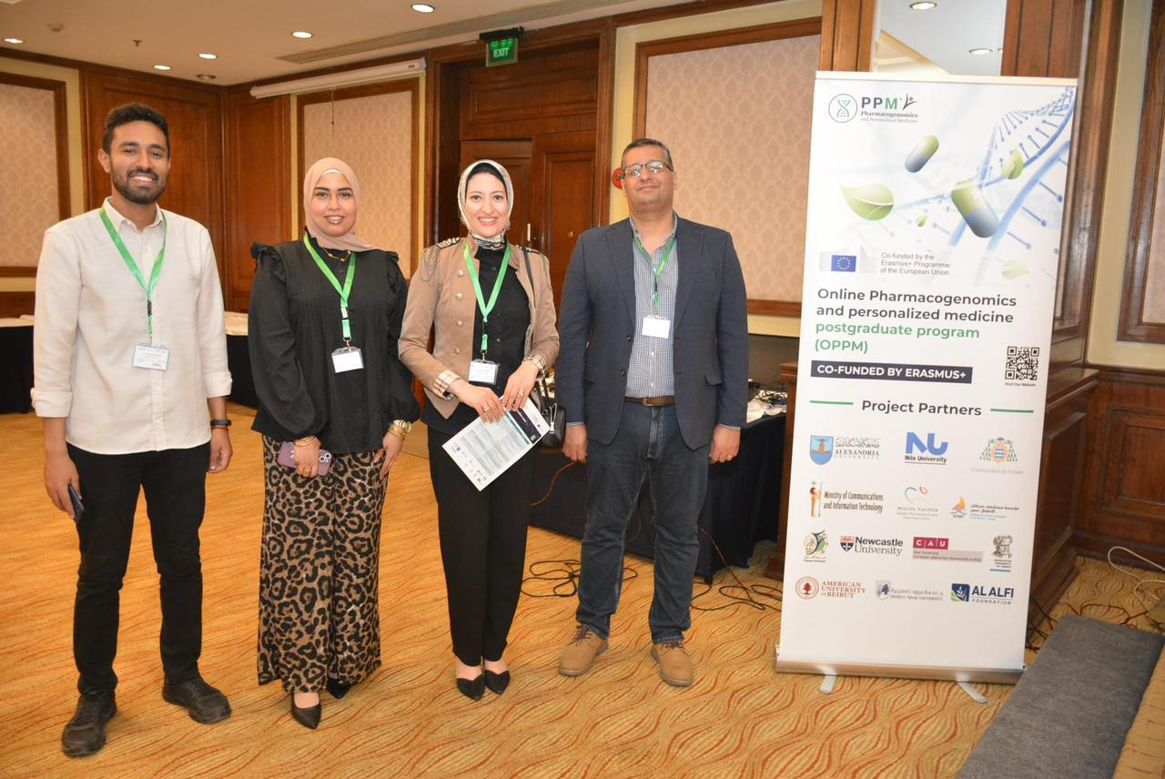
International & Local Confenernce

Slide 19

External Mission
name | Functional | Deptment | State | From | To
Gorge Hanaa | Assistant Lectuer | pharmaceutics | England | 27/2/2018 | 24/6/2024 للتدريب العملى
Marwa mohamed | Assistant Lectuer | pharmaceutics | England | 24/9/2018 | 3/11/2024 للتدريب العملى
Sherif ismail | Assistant Lectuer | pharmaceutics | England | 29/9/2018 | 30/5/2025 للتدريب العملى
Lina elsayed | Assistant Lectuer | Microbiology & immunology | England | 30/9/2020 | 29/3/2025
Esraa Abd El latif | Assistant Lectuer | Pharmacology & Toxicology | England | 29/9/2020 | 28/9/2024
Shams Fathy | Assistant Lectuer | pharmaceutics | England | 15/12/202 | 14/12/2024
Abd El Rahman Yassin | Assistant Lectuer | Industrial Pharmacy | England | 11/4/2022 | 10/4/2026
Heba Abd el megid | Assistant Lectuer | pharmaceutics | Holand | 24/8/2022 | 23/8/2026

Slide 20
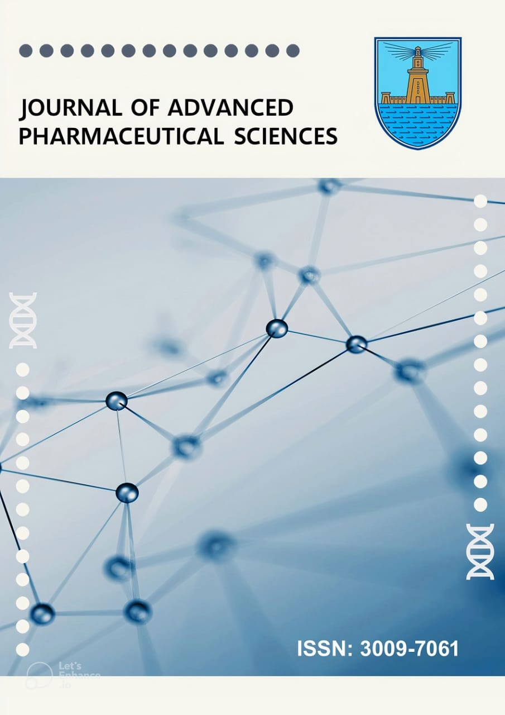
JOURNAL OF ADVANCED PHARMACEUTICAL SCIENCES
The Journal was evaluated by the Supreme Council of Universities and received a score of 6.5/7

Slide 21
An EDITORIAL BOARD for the Faculty magazine was formed in the gradue studies committee at the session held on 11/3/2023 and the Faculty council held on 17/3/2023 and extending until 24/3/2023 by the following gentleman whose names are:
الاسم | الاسم | الاسم
Prof. Dr. Amal Hassan El-kamel- Emeritus Professor in Pharmaceutics | Dr. Noha Alaa Eldin Hassan | Dr. Heba Abd El Azim
Prof. Dr. Eman Shawky Anwer – Professor and chairman of the department council of Pharmacognosy | Dr. Radwa Emad | Dr. Marwa Shoir
Prof. Dr. Mohammed Maher Mohammed | Dr. Sarah El Lakany | Dr. Ahmed Abel Elmoniem
Prof. Dr. Amira Fawzy El-yazbi | Dr. Salma El Habashy | Dr. Assr Fazwy
Dr. Ahmed Said Belal | Dr Salwa Abo Ragih | Dr. Ali Amin
Dr. Reham Said Ibrahim | Dr. Hala Shafiq | Dr. Shams Tarek
Dr. Parihan El zahar | Dr. Maikel Gorge | Dr. Sarah El Garwani
Dr. Reham Mohammed El-moslmany | Dr. Reem Hassan El hamamy | Dr. Asmaa Hossam
Dr. Asmaa Ashour | Dr. Hadel Adel | Dr. Ahmed Foad
Dr. Abd El Rahman zakria | Dr. Walaa Metwaly | Dr. Aya Refaat

Slide 22
The ISSN was obtained for the Faculty's journal " JOURNAL OF ADVANCED PHARMACEUTICAL SCIENCES “ in November 2023
Issue 2
Issue 1
ISSUE 2 in June 2024
ISSUE 1 in January 2024
1 | Hospital and Clinical Pharmacy
1 | Medicinal and Pharmaceutical Chemistry
3 | Pharmaceutical Analytical Chemistry
1 | Pharmaceutical Microbiology
1 | Pharmaceutics and Nanotechnology
1 | Hospital and Clinical Pharmacy
4 | Pharmaceutical Analytical Chemistry
2 | Pharmaceutics and Nanotechnology
3 | Pharmacognosy and Phytochemistry

Slide 23
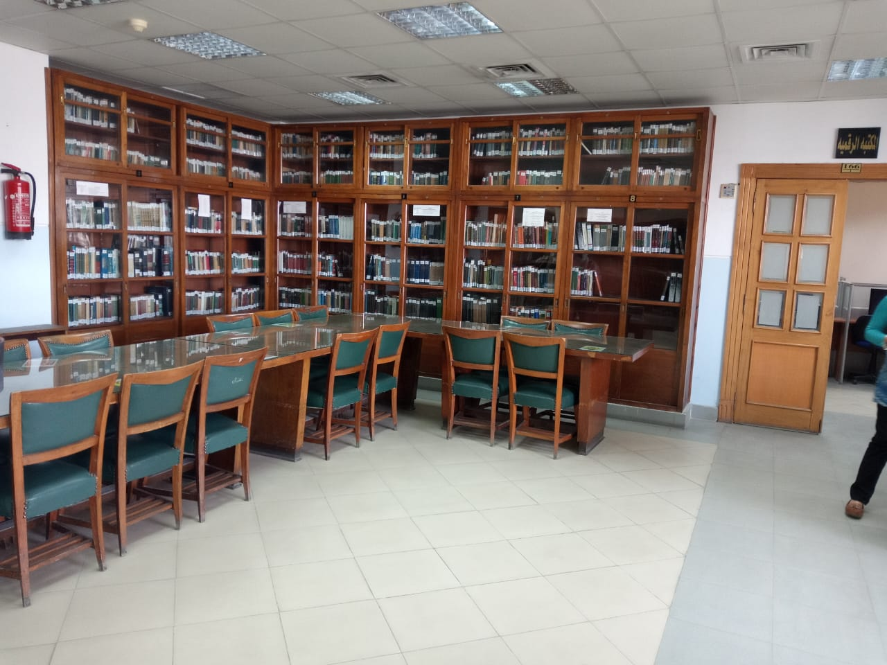
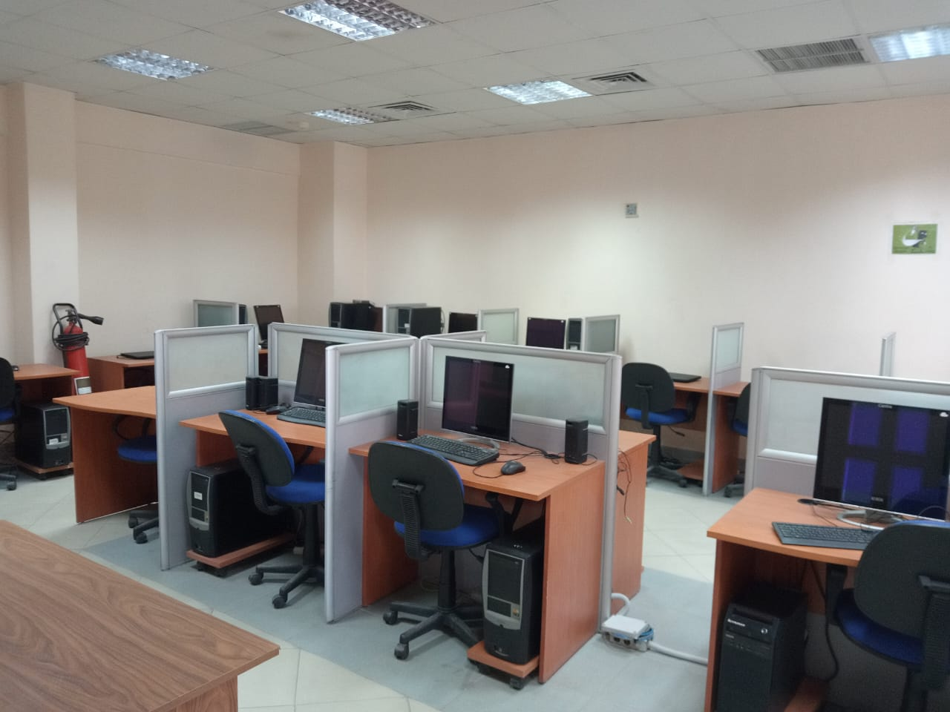
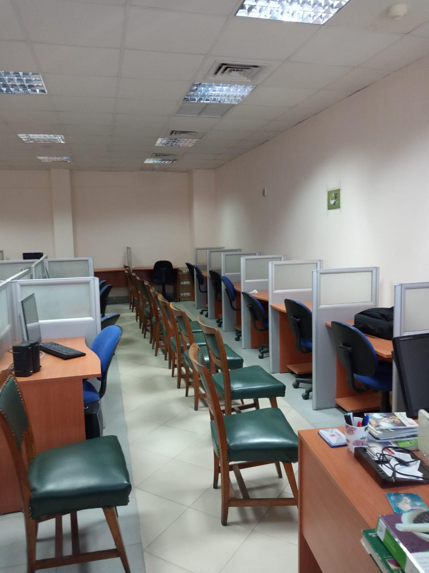
Faculty library
9 books, other than British Pharmacopeia, were purchased for approximately 66.719 thousand pounds
The book has been added to the Faculty library
Pharmacotherapy Principles and Practice Fifth Edition .2019
Natural poison and venom Phytochemical in medicinal Plants Nutrimetabolomics
INSTRUMENTAL ANALYTICAL CHEMISTRY ROBINSON 2022
GREEN APPROACHES FOR CHEMICAL ANALYSIS * Emanuela Gionfriddo2024
Chemical Biology & drug Design
Razdan Drug Design 2023
Nanotechnology in drug delivery and pharmaceuticals by toby cabral.2023
ESSENTIALS OF HOSPITAL INFECTION CONTROL
production technology for medicinal and aromatic cropsChhaya singh
British pharmacopeia 2024

Slide 24



Faculty members benefiting from local/international academic exchange programs
Member Name | Scientific visit place | From Date | To Date
DR HEBA BARAKAT | Sararland university, Germany ( Erasmus + KA171) | 2023/08/23 | 2023/08/30
DR RIHAM ELMOSLEMANI | Sararland university, Germany ( Erasmus + KA171) | 2023/08/23 | 2023/08/30
DR SARA EL GARAWANY | Sararland university, Germany ( Erasmus + KA171) | 09-يناير | 29-يوليه
PROF DR MERVET KASSEM | Algeria, IAEA | 2023/06/18 | 2023/06/23
DR. SAMAH ELSOHAFY | Algeria, IAEA | 2023/06/18 | 2023/06/23
DR MOHAMED ABDEL NABY | JEDDAH, SEOUDI ARABIA | 2024/04/20 | 2024/04/23
Prof DR. AHMED EL-MALLAH | Beirut, Lebanon | 2023/09/18 | ديسمبر-23
DR. DOAA ISSA | Beirut , Lebanon | 2023/09/15 | ديسمبر-23
PROF DR. ALYAA RAMADAN | Angers University, France | اول سبتمبر 2022 | لمدة اسبوعين
PROF DR AHMED WAHID | Newcastle- England | 2021/12/03 | 2022/02/15

Slide 25
New Students in Diploma during academic year 2023-2024
18 St.
33 St.
Cosmetic Preparations and Entrepreneurship
Hospital and Clinical Pharmacy
Pharmacogenomics
Biochemical Analysis
46 St.
4 St.

Slide 26
The Students have been awarded Diploma in 2023-2024

Slide 27

Professional Degree Pharm D
Recipients 2023-2024
New 2023-2024
Foreign |  | Egyptian
Male | Female | Male | Female
0 | 0 | 7 | 49
Foreign |  | Egyptian
Male | Female | Male | Female
1 (Yemen) | 1 (Sudan) | 9 | 144

Slide 28
Registered Student and graduates in Doctor of Philosophy in Pharmaceutical Sciences in 2023-2024
Pharmaceutics
7 Students (N)
3 Students (G)
Pharmacology & Toxicology
2 Students (N)
5 Students (N)
3 Students (G)
Pharmacognosy
5 Students (N)
1 Students (G)
4 Students (N)
2 Students (G)
Clinical Pharmacy and Pharmacy Practice
Pharmaceutical Analytical Chemistry
3 Students (N)
Biochemistry
3 Students (N)
1 Students (G)
4 Students (N)
Microbiology & Immunology
Pharmaceutical Chemistry

Slide 29

Registered Student and graduates in Master in Pharmaceutical Sciences in 2023-2024
Department | New |  | Recipients
 | Egyptian | Foreign | Egyptian | Foreign
Pharmaceutics | 18 | 1 | 10 | 0
Pharmaceutical Analytical Chemistry | 6 | 0 | 1 | 0
Pharmacognosy | 5 | 0 | 4 | 1
Biochemistry | 4 | 0 | 2 | 0
Pharmaceutical Chemistry | 8 | 0 | 4 | 0
Clinical Pharmacy & Pharmacy Practice | 19 | 0 | 4 | 0
Microbiology & Immunology | 6 | 0 | 2 | 0
Pharmacology & Toxicology | 4 | 1 | 3 | 0

Slide 30


